Slide 1
Embedding emotion coaching in an early years setting: its implementation and impact from practitioners’ perspectives
Esther Glaser

Slide 2
Background
Challenging climate for early years sector
Social and emotional difficulties in under 5s
Limited research on emotion coaching in early years settings
Virtual School project

Slide 3
Research objectives
Investigate the impact emotion coaching has had on children’s emotional development
Describe and evaluate how emotion coaching strategies have been embedded by practitioners and to what effect
Consider the influence of practitioners’ meta-emotion on the emotion coaching of children

Slide 4
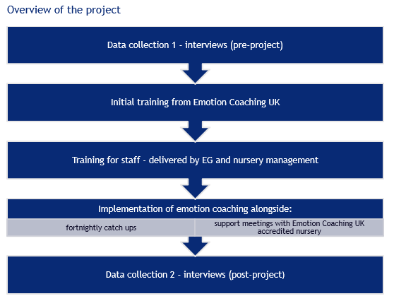
Notes:
Methodology:
The project took place over the course of 12 weeks, starting on 17th January 2022 and ending on 8th April 2022.
One early years setting – eager to develop practice and in the area of children’s emotional wellbeing. They currently have over 120 children attending and 30 members of staff.
Qualitative methods – semi-structured interviews
Analysis – thematic analysis, coding

Slide 5
Reflections, conclusions and recommendations
Investigate the impact emotion coaching has had on children’s emotional development
Difficult to quantify
Shift in focus to objective 3 – meta-emotion
Practitioners observed positive impact of EC on children

Slide 6
Reflections, conclusions and recommendations
2. Describe and evaluate how emotion coaching strategies have been embedded by practitioners and to what effect
Steps 1 and 2 of EC were found to be most valuable
Why not steps 3 and 4?

Slide 7
Reflections, conclusions and recommendations
3. Consider the influence of practitioners’ meta-emotion on the emotion coaching of children
Mental and emotional wellbeing of practitioners crucial
Impact not easily qualified

Slide 8
Reflections, conclusions and recommendations
Other considerations
EC enabled positive change to happen…
…but what led to this success? Can it be replicated and yield the same results?
Explore use of support networks
Springboard for further research in the early years

