Slide 1
Natasha Hannaway and Charlotte Holloway What it was like to set up and lead the new GSPEC parenting course?

Slide 2
School Context:
High Deprivation.
High need (SEND 38% and PP 40%).
Low parental engagement.
Disapproving/inappropriate parenting style.

Slide 3
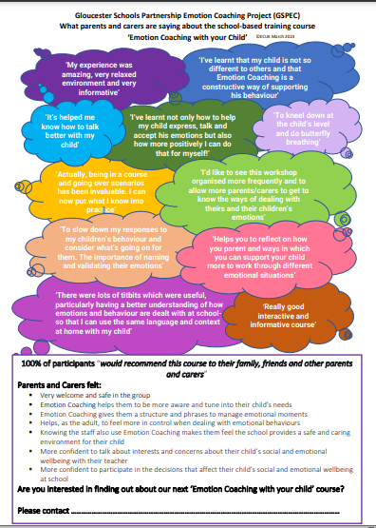
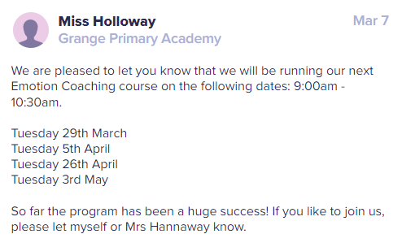
Setting up the group:
Class dojo invite open to all parents.

Slide 4
We had our long term focus group, were aiming at “easier to reach and engage parents”. We recruited 7 parents – all very high tariff children. 5 completed the course in November. Training and supervision from Louise.

Slide 5
Course conditions:
After drop-off in the morning.
Siblings welcome.
Coffee and biscuits.
Regular communication so that they remember to come.

Slide 6
Impact:
No more drop kicking!
Parents spreading the news.
Parents telling others how to parent.
Calmer children.
Better relationships with parents – one now works for us as a cleaner.

Slide 7
Further courses
Cohort 2: January (8 said they would join, 3 completed the course).
During Covid. Later in the evening (4.30 – 6.00).
Although only 3, there was a big impact and one participant sent her husband to the third cohort.
Cohort 3: April (4 joined and completed the course).
9 – 10.30.

Slide 8
What would we change?
Make it very clear it is for ALL.
Stick to first thing in the morning.

Slide 9
This year:
I have completed training to be an ECUK Practitioner Trainer. I am a GSP Senior Emotion Coaching lead training staff within 4 other trust schools to deliver the Emotion Coaching sessions.
More cohorts will be run in my school.
Pastoral support worker is joining me – important to work with another member of staff (safeguarding, personal anecdotes)

